Slide 1
Computer Organization & Design —The Hardware/Software Interface
Chapter 6 I/O devices

Slide 2
Contents
6.1 Introduction
6.2 Dependability, Reliability, and Availability
6.3 Disk Storage
6.4 Flash Storage
6.5 Connecting Processors, Memory, and I/O Devices
6.6 Interfacing I/O Devices to the Processor, Memory, and Operating System
6.7 I/O Performance Measures: Examples from Disk and File Systems
6.8 Designing an I/O System
6.9 Parallelism and I/O: Redundant Arrays of Inexpensive Disks

Slide 3
6.1 Introduction
I/O Designers must consider many factors
such as expandability and resilience(resume),as well as performance.
Assessing I/O system performance is very difficult.
In different situations, needs use different measurements.
Performance of I/O system depends on:
connection between devices and the system
the memory hierarchy
the operating system

Slide 4
A typical collection
of I/O devices

Slide 5
Three characteristics
Behavior
Input (read once), output (write only, cannot read) ,or storage (can be reread and usually rewritten)
Partner
Either a human or a machine is at the other end of the I/O device, either feeding data on input or reading data on output.
Data rate
The peak rate at which data can be transferred between the I/O device and the main memory or processor.

Slide 6
Two ways to measure throughput
I/O bandwidth can be measured in two different ways according to different situations:
1.How much data can we move through the system in a certain time? For examples, in many supercomputer applications, most I/O requires are for long streams of data, and transfer bandwidth is the important characteristics.
2.How many I/O operations can we do per unit of time?
For example, National Income Tax Service mainly
processes large number of small files.

Slide 7
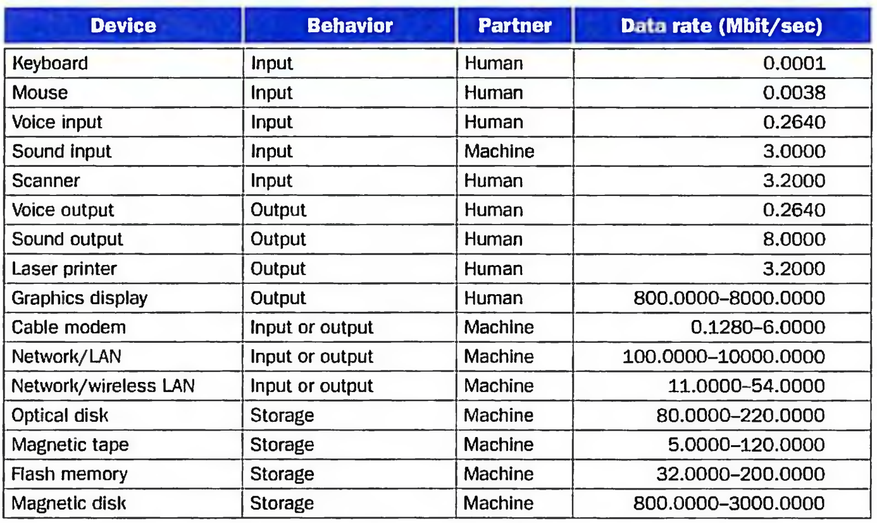
The diversity of I/O devices

Slide 8
Important but neglected
“The difficulties in assessing and designing I/O systems have often relegated I/O to second class status”
“courses in every aspect of computing, from
programming to computer architecture often
ignore I/O or give it scanty coverage”
“textbooks leave the subject to near the end,
making it easier for students and instructors to skip it!”

Slide 9
Amdahl’s law remind us that ignoring I/O is dangerous
Assume:
a bench mark executes in 100 seconds of elapsed time , where 90 seconds is CPU time and the rest is I/O time.
CPU time improves by 50% per year, but I/O time doesn’t improve.
After five years, the improvement in CPU performance is 7.5 times.
The elapsed time is reduced to
90/7.5+10=12+10=22 seconds.
So, the improvement in elapsed time is only 4.5 times.

Slide 10
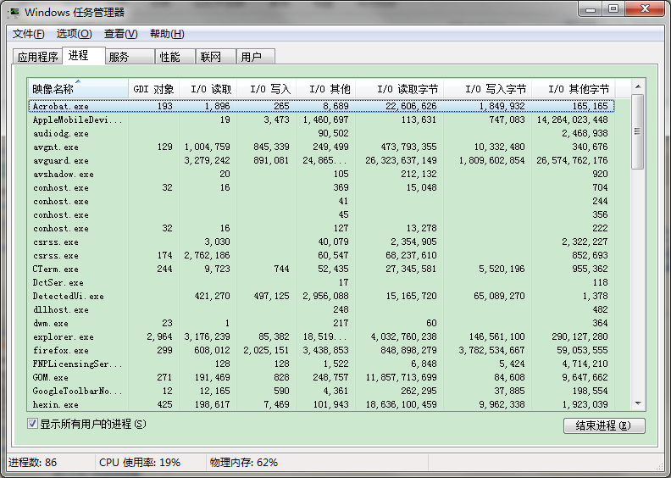
任务管理器（IO相关）

Slide 11
6.2 Dependability, Reliability, and Availability
Dependability（可依赖性）
Computer system dependability is the quality of delivered service such that reliance can justifiably be placed on this service. The service delivered by a system is its observed actual behavior as perceived by other system (s) interacting with this system’s users. Each module also has an ideal specified behavior, where a service specification is an agreed description of the expected behavior. A system failure occurs when the actual behavior deviates from the specified behavior.
service specification:
1. Service accomplishment, where the service is delivered as specified
2. Service interruption, where the delivered service is different from the specified service

Slide 12
Reliability(可靠性）
MTTF mean tine to failure
MTTR mean time to repair
MTBF (Mean Time Between Failures) = MTTF+ MTTR
Availability（可用性）
MTTF
Availability=
MTTF+MTTR

Slide 13
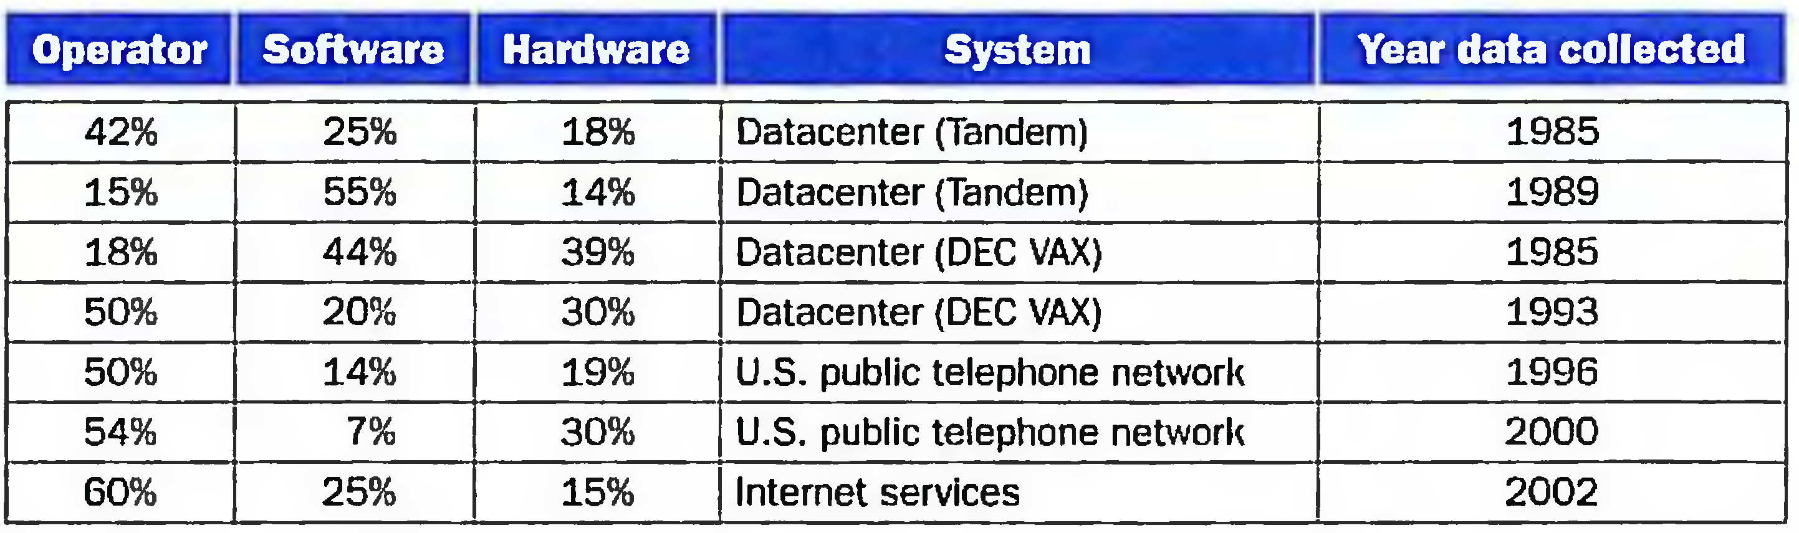
Summary of studies of reasons for failures

Slide 14
Three ways to improve MTTF
Fault avoidance:
preventing fault occurrence by construction
Fault tolerance:
using redundancy to allow the service to comply with the service specification despite faults occurring, which applies primarily to hardware faults
Fault forecasting:
predicting the presence and creation of faults, which applies to hardware and software faults

Slide 15
6.3 Disk Storage
Nonvolatile
the data remains even when power is removed.
magnetic disks
hard disks
Hard Disc Drive
HD
1956, IBM, 30MB
温彻斯特式硬盘(温彻斯特来福枪)
1980，IBM员工创办SEAGATE
Increase 25%~30% per year
Vender： Western Digital、 Seagate、 Toshiba、EMC

Slide 16
The organization of hard disk
platters:
disk consists of a collection of platters （1-4）, each of which has two recordable disk surfaces
tracks:
each disk surface is divided into concentric circles（ typically 10,000 to 50,000 ）
sectors:
each track is in turn divided into sectors, which is the smallest unit that can be read or written（ each track may have 100 to 500 sectors. ）（512B-4096B）

Slide 17
Disks are organized into platters, tracks, and sectors

Slide 18
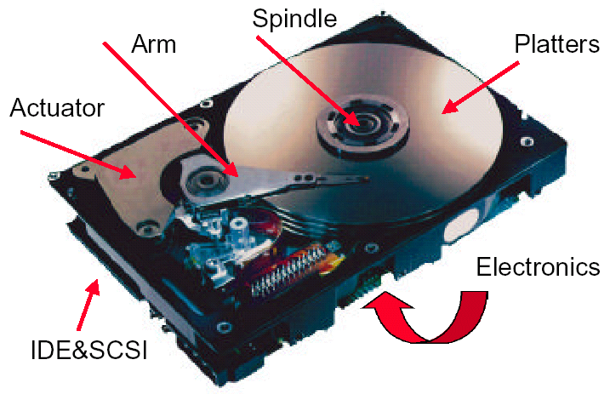
What’s Inside A Disk Drive?

Slide 19
Access the disk
Seek: position read/write head over the proper track
minimum seek time
maximum seek time
average seek time (3 to 14 ms)
Rotational latency: wait for desired sector
average latency is the half-way round the disk.
0.5
rotation
0.5
rotation
Average rotational latency =
=
5400RPM
5400RPM
60
seconds
/
minute
= 0.0056
seconds =
5.6 ms
0.5
rotation
0.5
rotation
Average rotational latency =
=
15000RPM
15000RPM
60
seconds
/
minute
= 0.0020
seconds =
2.0 ms

Slide 20
Transfer: time to transfer a sector (512 B/sector) function of rotation speed, Transfer rate today’s drives - 30 to 80 MBytes/second
Disk controller: which control the transfer between the disk and the memory
Disk Read Time 512/sector
Access Time = Seek time + Rotational Latency + Transfer time + Controller Time
0.5
0.5KB
＝6ms ＋
＋
＋ 0.2ms
10,000PRM
50MB/sec
＝6ms ＋ 3.0 ＋ 0.01 ＋ 0.2 ＝9.2ms
Assuming the measured seek time is 25% of the calculated average
Access Time ＝25%×6ms ＋ 3.0 ms＋ 0.01ms ＋ 0.2ms ＝4.7ms

Slide 21
硬盘接口
IDE接口
Integrated Drive Electronics
电子集成驱动器，PATA并口，后发展为ATA
Advanced Technology Attachment (ATA)
A command set used as a standard for I/O devices that is popular in the PC.
SATA：Serial ATA，串口硬盘，2001年取代了ATA
SATA II：intel & Seagate，外部传输率从SATA的150MB/s提高到300MB/s
Small Computer Systems Interface (SCSI)
与IDE接口不一样，用于小型机以上
A command set used as a standard for I/O devices.
应用范围广、多任务、带宽大、CPU占用率低，以及热插拔等优点，但较高的价格
SAS（Serial Attached SCSI）

Slide 22
Disk Size
5.25英寸硬盘：早期用于台式机，已退出历史舞台。
3.5寸台式机硬盘
主流，广泛用于各种台式计算机。
2.5寸笔记本硬盘
用于笔记本电脑，桌面一体机，移动硬盘及便携式硬盘播放器
1.8寸微型硬盘
用于超薄笔记本电脑，移动硬盘及苹果播放器。
1.3寸微型硬盘
产品单一，三星独有技术，仅用于三星的移动硬盘。
1.0寸微型硬盘
最早由IBM公司开发， MicroDrive微硬盘（简称MD）。因符合CFII标准，所以广泛用于单反数码相机。
0.85寸微型硬盘
产品单一，日立独有技术，已知用于日立的一款硬盘手机，前Rio公司的几款MP3播放器也采用了这种硬盘。

Slide 23
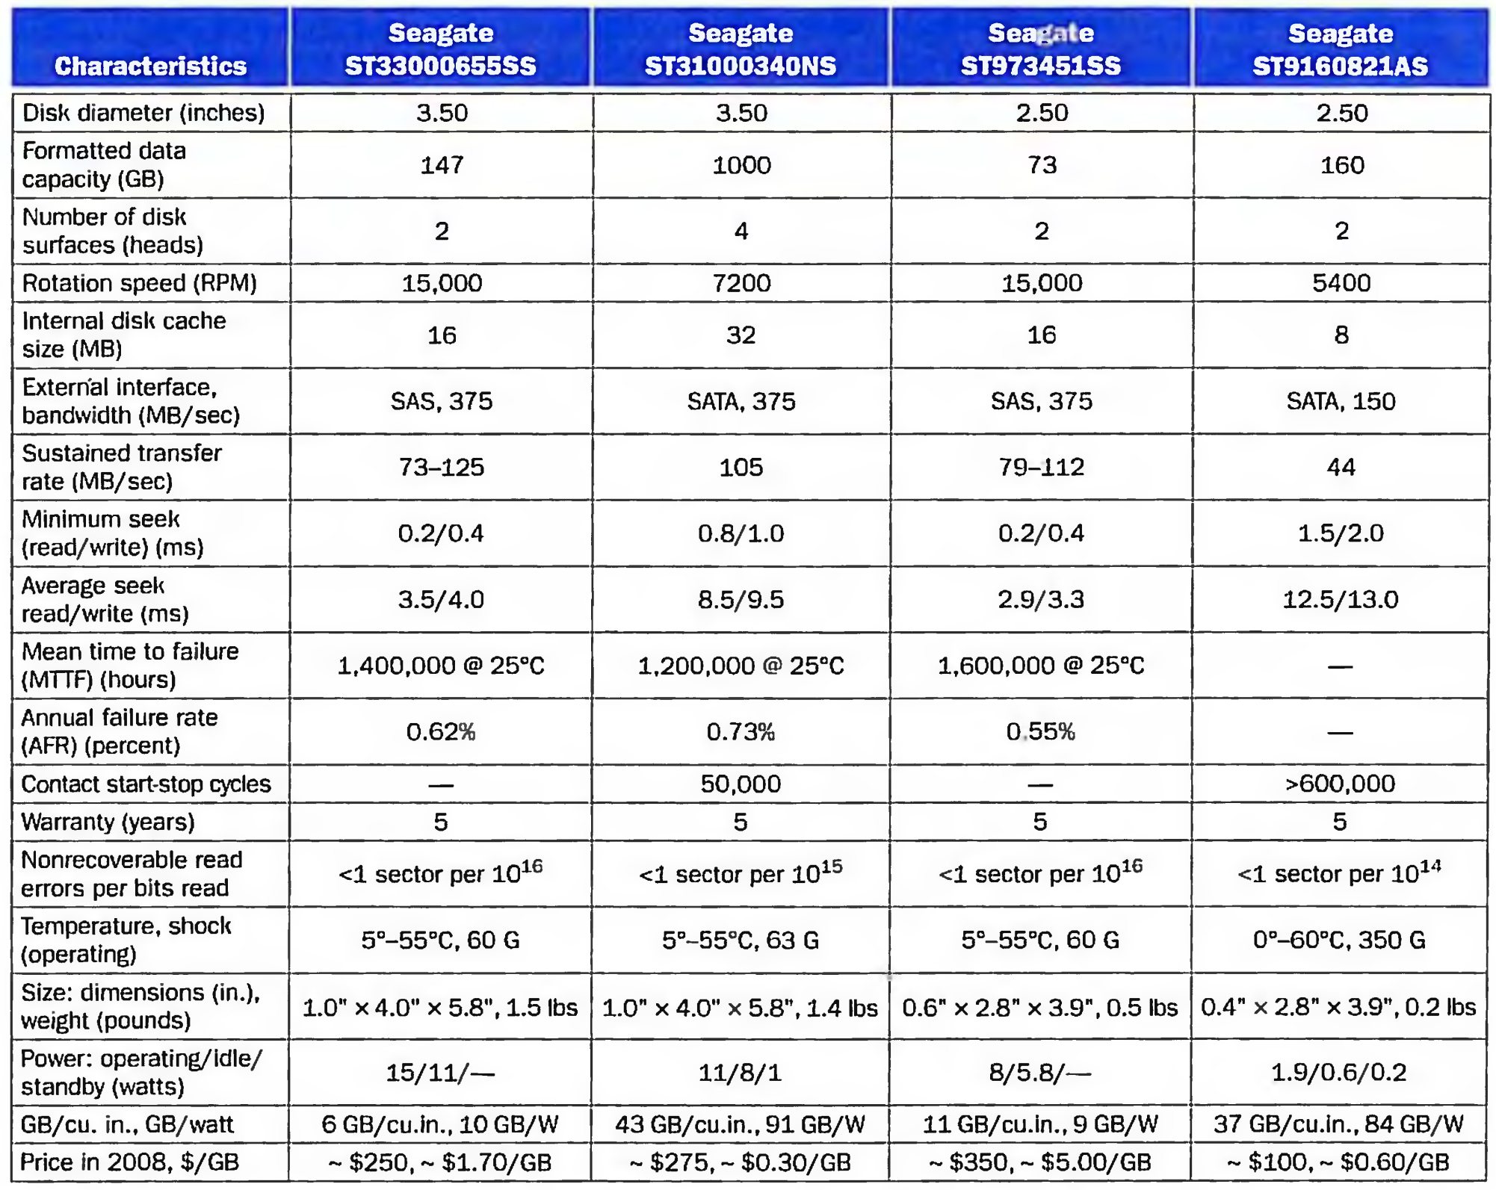

Slide 24
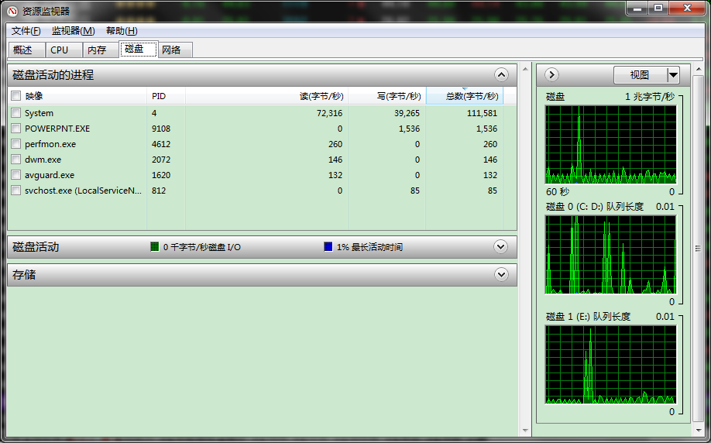
资源监视器（磁盘）

Slide 25
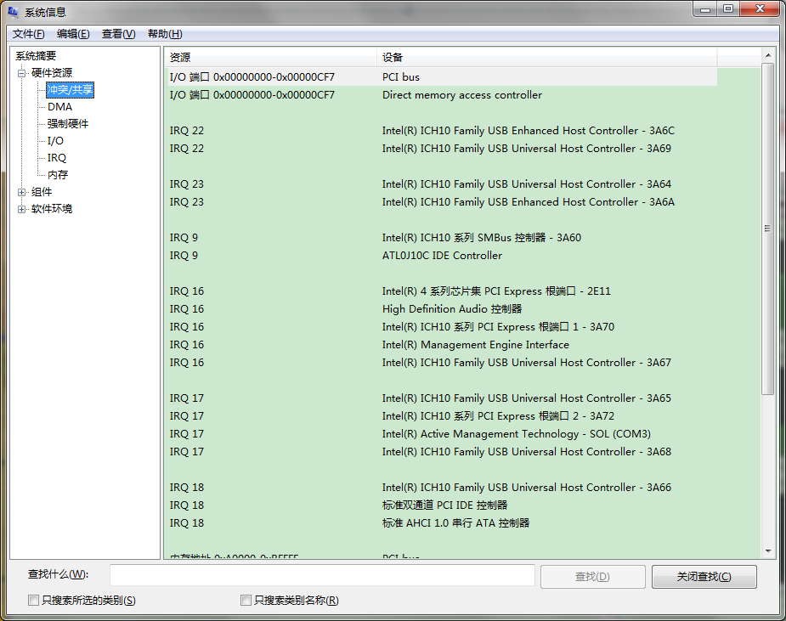
系统信息

Slide 26
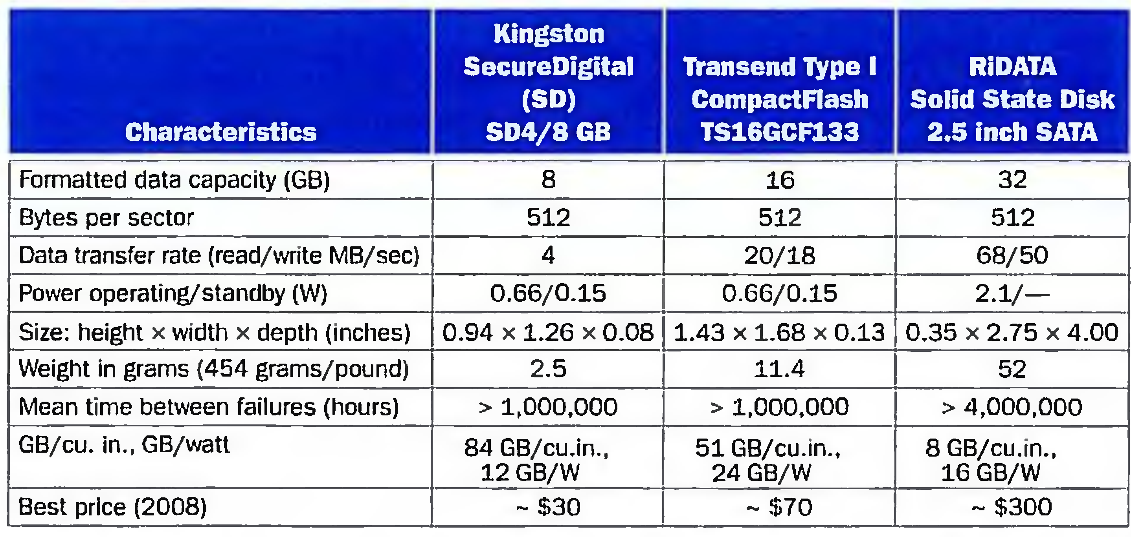
6.4 Flash Storage
Characteristics of three flash storage products.
U盘、CF卡、SM卡、SD/MMC卡、记忆棒、XD卡、MS卡、TF卡

Slide 27
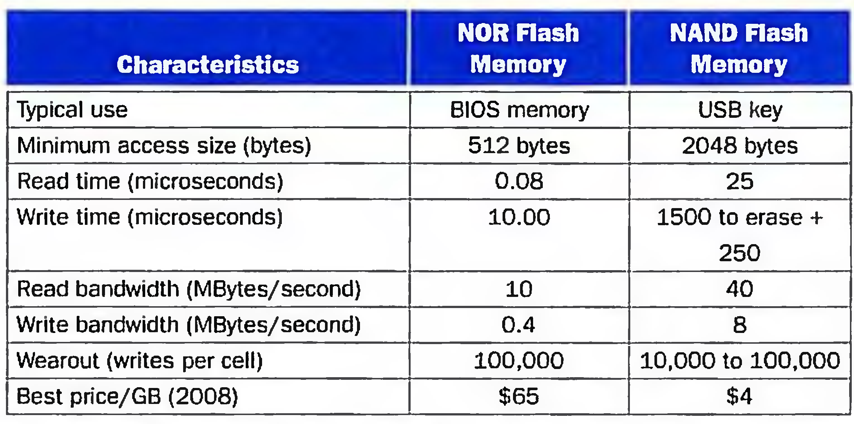
Nor flash/Nand flash
NOR型闪存更像内存，有独立的地址线和数据线，但价格比较贵，容量比较小
NAND型更像硬盘，地址线和数据线是共用的I/O线，类似硬盘的所有信息都通过一条硬盘线传送一般，而且NAND型与NOR型闪存相比，成本要低一些，而容量大得多

Slide 28
SSD
Solid State Disk、IDE FLASH DISK、Serial ATA Flash Disk
最大容量为1TB
接口规范和定义、功能及使用方法
与普通硬盘的完全相同，在产品外形和尺寸上也完全与普通硬盘一致，包括3.5"，2.5"，1.8"多种类型
抗震性极佳
固态硬盘没有普通硬盘的旋转介质
工作温度很宽
扩展温度的电子硬盘可工作在-45℃～+85℃
广泛应用于军事、车载、工控、视频监控、网络监控、网络终端、电力、医疗、航空等、导航设备等领域。

Slide 29
6.5 Connecting Processors, Memory, and I/O Devices
questions
How is a user I/O request transformed into a device command and communicated to the device?
How is data actually transferred to or from a memory location?
What is the role of the operating system?

Slide 30
three characteristics of I/O systems:
1. Multiple programs using the processor share the I/O system.
2. I/O systems often use interrupts (externally generated exceptions) to communicate information about I/O operations. Because interrupts cause a transfer to kernel or supervisor mode, they must be handled by the operating system (OS).
3. The low-level control of an I/O device is complex, because it requires managing a set of concurrent events and because the requirements for correct device control are often very detailed.

Slide 31
Buses
Shared communication link (one or more wires)
Difficult design:
may be bottleneck
length of the bus
number of devices
tradeoffs (fast bus accesses and high bandwidth)
support for many different devices
cost

Slide 32
A bus contains two types of lines
Control lines, which are used to signal requests and
acknowledgments, and to indicate what types of
information is on the data lines.
Data lines, which carry information (e.g., data, addresses, and
complex commands) between the source and the destination.
Bus transaction
include two parts: sending the address and receiving or
sending the data
two operations
input: inputting data from the device to memory
output: outputting data to a device from memory

Slide 33
The steps of an output operation.
Initial a read from memory. Control lines signal a read request to memory, while the data lines contain the address
Memory access the data.
Memory transfers data and signal data is available. The device stores data as it appears on the bus.

Slide 34
The steps of an input operation.
Control lines indicate a write request for memory, while the data lines contain the address
When the memory is ready, it signals the device, which then transfers the data. The memory will store the data as it receives it . The device need not wait for the store to be completed.

Slide 35
Types of buses:
processor-memory (short high speed, custom design)
backplane (high speed, often standardized, e.g., PCI)
I/O (lengthy, different devices, standardized, e.g., SCSI)
Older PCs often use a single bus for processor-to-memory communication, as well as communication between I/O devices and memory.

Slide 36
A separate bus is used for processor-memory traffic. The I/O bus use a bus adapter to interface to the processor-memory bus.
A separate bus is used for processor-memory traffic. A small number of backplane buses tap into the processor-memory bus.

Slide 37
Synchronous vs. Asynchronous
Synchronous bus use a clock and a synchronous protocol,
fast and small but every device must operate at same rate
and clock skew requires the bus to be short
Asynchronous bus don’t use a clock and instead use
handshaking
Our example ,which illustrates how asynchronous buses
use handshaking, assumes there are three control lines.
ReadReq: Used to indicate a read request for memory. The address is
put on the data lines at the same time.
DataRdy: Used to indicate that data word is now ready on the data lines.
Ack: Used to acknowledge the ReadReq or the DataRdy signal of the
other party
Handshaking protocol

Slide 38
Example: The asynchronous handshaking consists of seven steps to read a word from memory and receive it in an I/O device.
When memory sees the ReadReq line, it reads the address from the data bus, begin the memory read operation，then raises Ack to tell the device that the ReadReq signal has been seen.
I/O device sees the Ack line high and releases the ReadReq data lines.
3. Memory sees that ReadReq is low and drops the Ack line.

Slide 39
Example: The asynchronous handshaking consists of seven steps to read a word from memory and receive it in an I/O device.
When the memory has the data ready, it places the data on the data lines and raises DataRdy.
5. The I/O device sees DataRdy, reads the data from the bus , and signals that it has the data by raising ACK.
The memory sees Ack signals, drops DataRdy, and releases the data lines.
7. Finally, the I/O device, seeing DataRdy go low, drops the ACK line, which indicates that the transmission is completed.

Slide 40
These finite state machines implement the control for handshaking protocol illustrated in former example.

Slide 41
Obtaining Access to the Bus
“Without any control, multiple device desiring to
communicate could each try to assert the control and
data lines for different transfers!”
So,a bus master is needed. Bus masters initiate and control all bus requests.
e.g., processor is always a bus master.
Example: the initial steps in a bus transaction with a
single master (the processor).
First, the device generates a bus request to indicate to the processor that it wants to use the bus.

Slide 42
The processor responds and generates appropriate bus control signals. For example, if the devices wants to perform output from memory, the processor asserts the read request lines to memory.
The processor also notifies the device that its bus request is being processed; as a result, the device knows it can use the bus and places the address for the request on the bus.

Slide 43
Bus Arbitration
Deciding which bus master gets to use the bus next
In a bus arbitration scheme, a device wanting to use the
bus signals a bus request and is later granted the bus.
four bus arbitration schemes:
daisy chain arbitration (not very fair)(p670)
centralized, parallel arbitration (requires an arbiter), e.g., PCI
self selection, e.g., NuBus used in Macintosh
collision detection, e.g., Ethernet
Two factors in choosing which device to grant the bus:
bus priority
fairness

Slide 44
Bus Standards
SCSI (small computer system interface)
PCI (peripheral component interconnect)
PCIE(PCI-Express) 1.0 2.0 3.0
IPI (intelligent peripheral interface)
IBMPC-AT IBMPC-XT
ISA EISA
USB 1.0. 2.0 3.0
IEEE1394

Slide 45
总线
总线的带宽
总线的带宽指的是一定时间内总线上可传送的数据量，即我们常说的每秒钟传送多少MB 的最大稳态数据传输率。与总线带宽密切相关的两个概念是总线的位宽和总线的工作时钟频率。
总线的位宽
总线的位宽指的是总线能同时传送的数据位数，即我们常说的32 位、64 位等总线宽度的概念。总线的位宽越宽则总线每秒数据传输率越大，也即总线带宽越宽。
总线的工作时钟频率
总线的工作时钟频率以MHz 为单位，工作频率越高则总线工作速度越快，也即总线带宽越宽。

Slide 46
ISA
IBM 公司于1981 年推出的基于8 位机PC/XT 的总线，称为PC 总线
为了能够合理地开发外插接口卡，由Intel 公司，IEEE 和EISA 集团联合开发了与IBM/AT 原装机总线意义相近的ISA 总线
ISA总线有98只引脚。其中62 线的一段基于8 位的PC 总线，可以独立使用，连接8位的扩展卡，而62 线与36线相加后就扩展成标准的16位ISA，连接16位的扩展卡

Slide 47
PCI
1991 年下半年，Intel公司首先提出了PCI 的概念
并联合IBM、Compaq、AST、HP、DEC 等100 多家公司成立了PCI 集团，其英文全称为：Peripheral Component Interconnect Special Interest Group(外围部件互连专业组)，简称PCISIG
PCI有32位和64位两种，32位PCI 有124 引脚，64位有188引脚，目前常用的是32位PCI
32 位PCI的数据传输率为133MB／s，大大高于ISA

Slide 48
PC104总线
1992年IEEE 开始着手为PC 和PC/AT 总线制定一个精简的IEEEP996 标准（草稿），PC104 作为基本文件被采纳，叫做IEEE P996.1 兼容PC 嵌入式模块标准
PC104有两个版本：8 位和16 位，分别与PC 和PC/AT 相对应
PC104PLUS 是专为PCI 总线设计的，可以连接高速外接设备

Slide 49
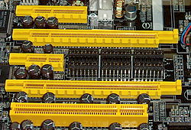
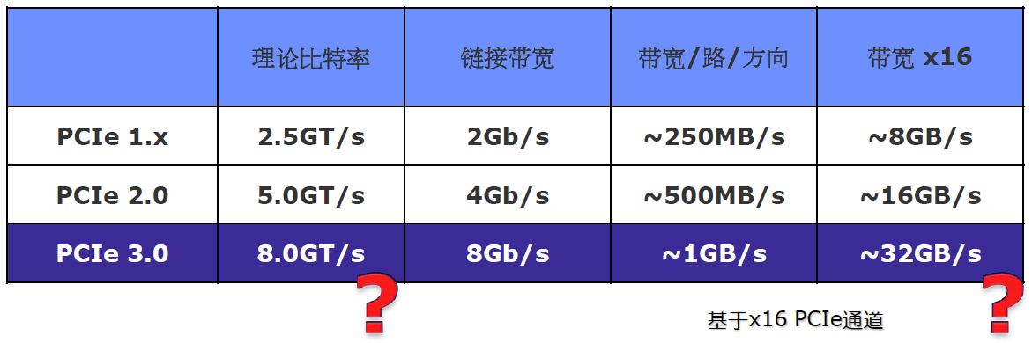
PCIE: PCI Express
PCI Express 1.0a,2003年
a data rate of 250 MB/s and a transfer rate of 2.5 GT/s.
PCI Express 1.1,2005年
PCI Express 2.0,2007年
data rate加倍到500 MB/s，throughput 16 GB/s
PCI Express 2.1
PCI Express 3.0，2010年
8 GT/s bit rate

Slide 50
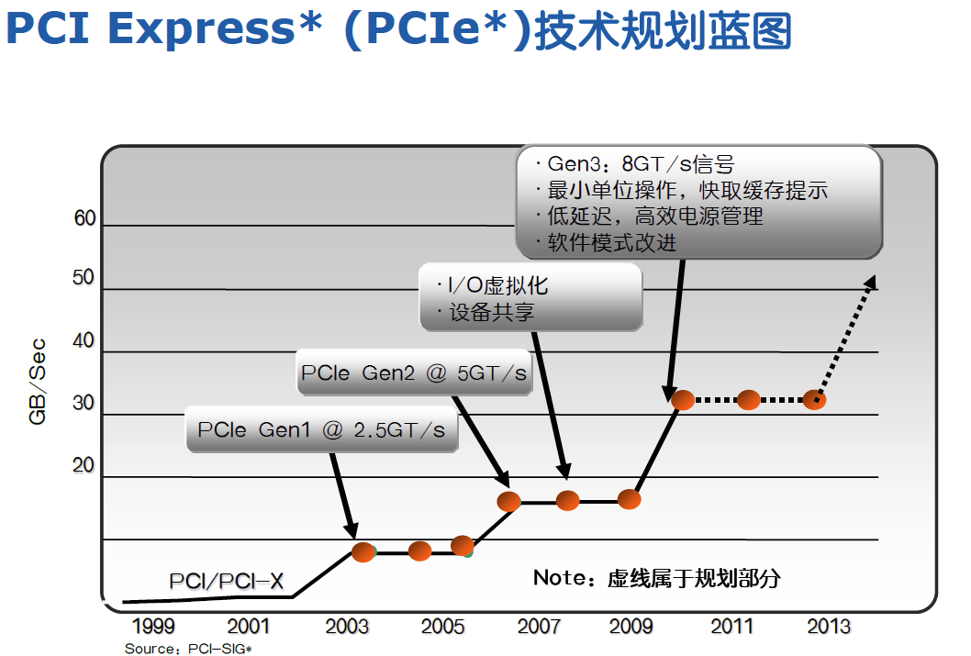

Slide 51
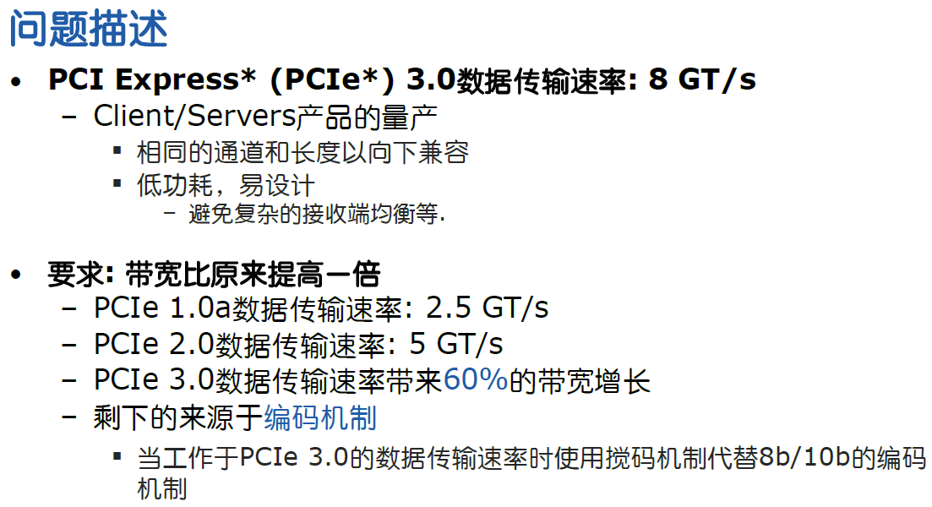

Slide 52
SPI总线
串行外围设备接口SPI（serial peripheral interface）总线技术是Motorola 公司推出的一种同步串行接口
SPI 总线是一种三线同步总线，因其硬件功能很强
总线上可以连接多个可作为主机的MCU，装有SPI 接口的输出设备，输入设备如液晶驱动、A/D 转换等外设
也可以简单连接到单个TTL 移位寄存器的芯片
总线上允许连接多个能作主机的设备，但在任一瞬间只允许有一个设备作为主机

Slide 53
I²C总线
I²C总线，全称内部集成电路（Internal Integrated Circuit）总线，主要用于连接微控制器和外围设备。
由Philips公司开发的二线式串行总线标准，最初被应用于音频和视频领域的设备开发，现今已在各种电子设备中得到了广泛的使用。
最主要的特点是它的简单性和高效性，占用非常小的空间，减少了整个电路板的规模和芯片引脚的数量，从而降低了互联的成本。

Slide 54
SMBus总线
系统管理总线（System Management Bus，SMBus）最初由Intel提出，应用于移动PC和桌面PC系统中的低速通讯。
SMBus的目标是通过一条廉价但功能强大的总线，来控制主板上的设备和收集设备的信息。
设备之间都可以通过SMBus总线传递消息，而不需要专门设计单独的控制总线，这样大大减少设备的引脚数。
Windows系统中显示的各种设备的制造商名称和型号等信息，都是通过SMBus总线收集的。主板监控系统中传送各种传感器的测量结果，以及BIOS向监控芯片发送命令，也是利用SMBus实现的。

Slide 55
CAN总线
CAN，全称为“Controller Area Network”，即控制器局域网，是国际上应用最广泛的现场总线之一
CAN 被设计作为汽车环境中的微控制器通讯，在车载各电子控制装置ECU 之间交换信息，形成汽车电子控制网络
CAN 是一种多主方式的串行通讯总线，基本设计规范要求有高的位速率，高抗电磁干扰性，而且能够检测出产生的任何错误

Slide 56
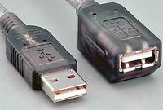
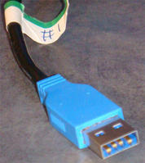
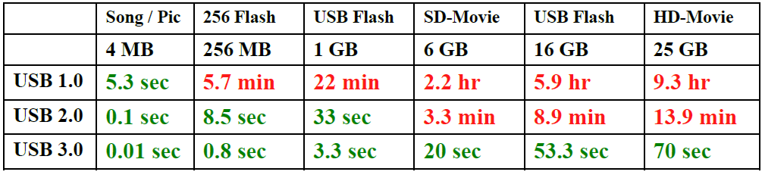
USB
USB全称Universal Serial Bus（通用串行总线）
将使用USB的外围设备连接到主机
在USB 的网络协议中，每个USB 的系统有且只有一个host
USB 最大的好处在于能支持多达127 个外设，并且可以独立供电 、并且支持热拔插
USB1.1中，所有设备只能共享1.5MB/s的带宽
USB2.0的最高传输速率为480Mbps，提升40倍。
USB 3.0规范于2008-11-18完成，提升10倍
理论最高速率是5.0Gbps，实际传输速率大约是3.2Gbps

Slide 57
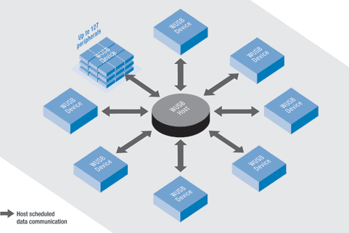
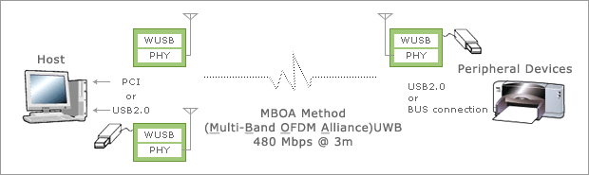
无线USB
WUSB，Wireless USB
利用最新的无线技术、通过USB接口扩展连接性的无线USB标准
基于由 IEEE 802.15.3 定义的超宽频(UWB)
高速的短距离通讯的宽带技术

Slide 58
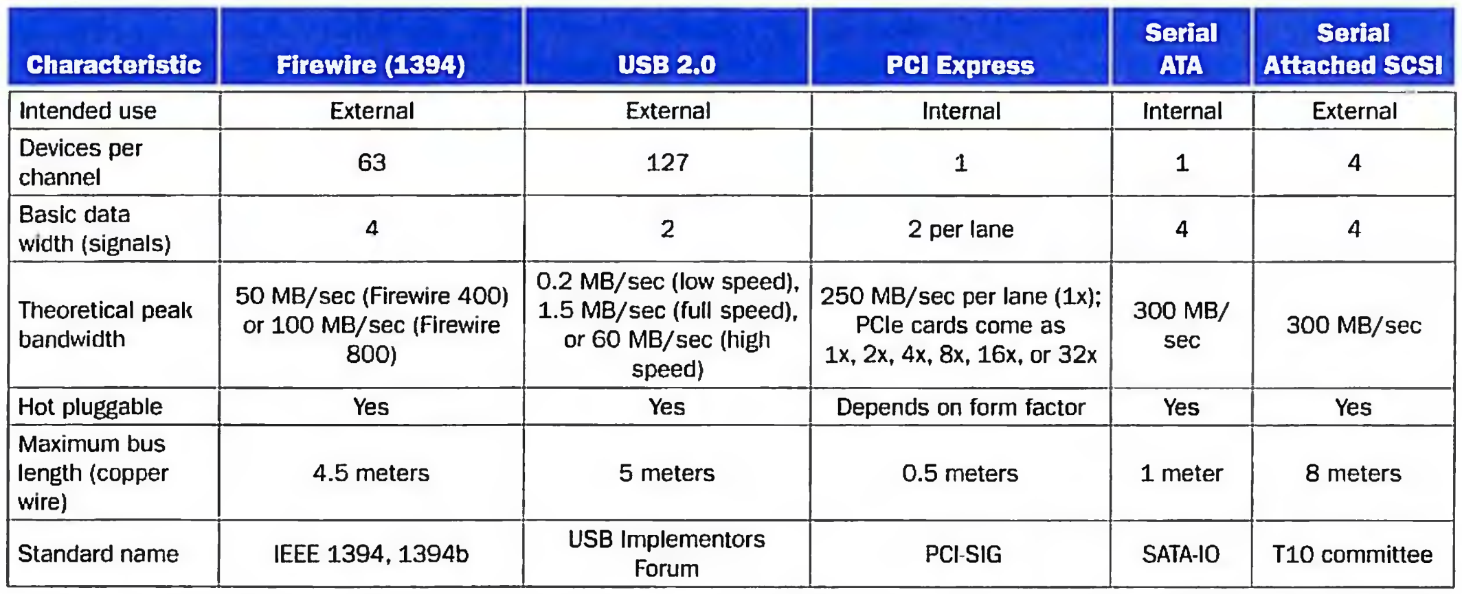
Key characteristics of five dominant I/O standards.

Slide 59
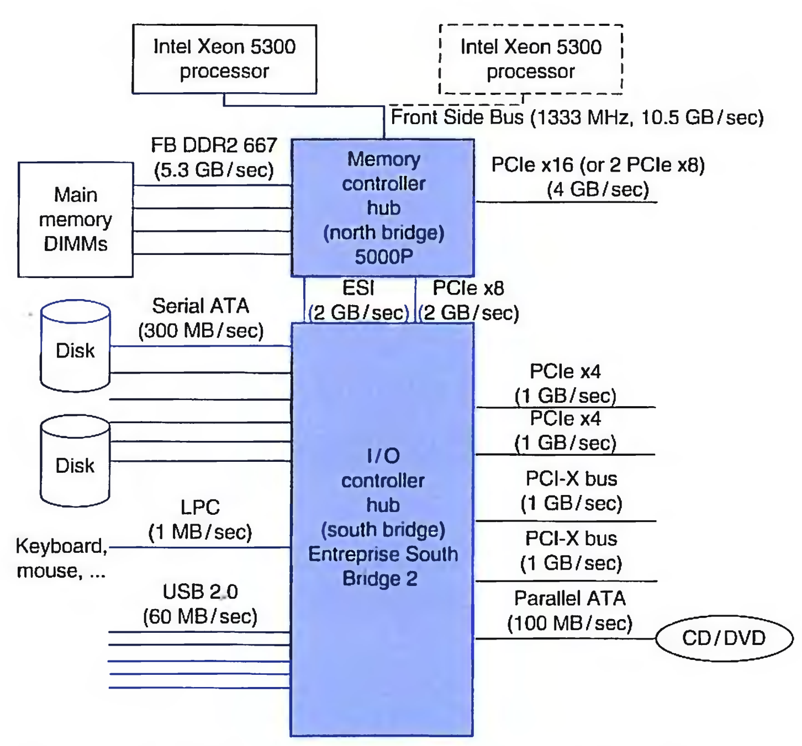
The I/0 Interconnects of the x86 Processors

Slide 60
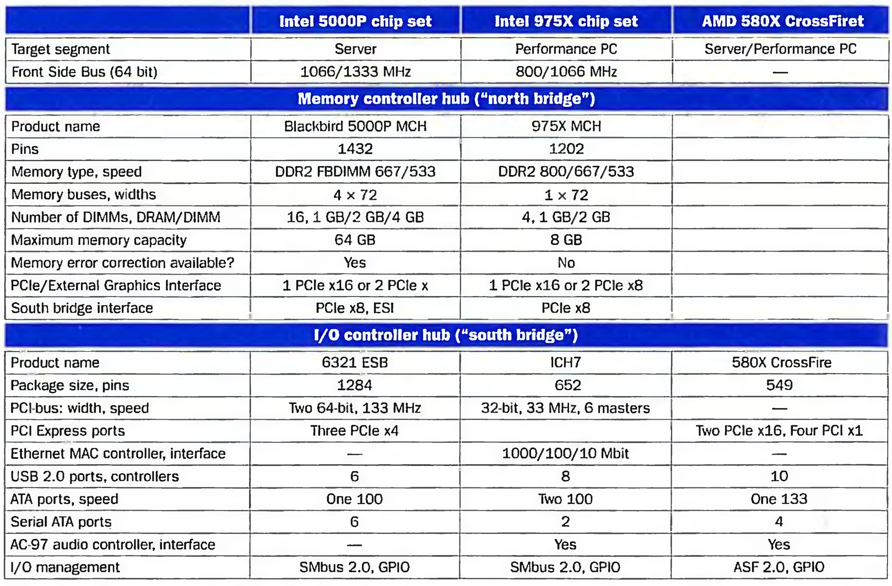

Slide 61
三大芯片
三大芯片
处理器
北桥
南桥
后两者合称芯片组
目前趋势
北桥部分做到处理器中，另外一部分与南桥合并

Slide 62
芯片组chip set
以往，芯片组由多颗芯片组成，慢慢的简化为两颗芯片
两个主要的主板芯片组：北桥和南桥
目前特指计算机主板或扩展卡上的芯片
单芯片芯片组
单个芯片设计，以增强性能
相关概念
主板Motherboard, Mainboard
主机板、系统板、逻辑板、母板、底板
最主要的器件为芯片组，以及各种接口（CPU插槽、硬盘插槽、内存插槽、PCIE插槽等）

Slide 63
北桥NorthBridge
也称为主桥（HostBridge），处理高速信号
接口：CPU、内存、AGP或PCI Express的端口
控制内存
Intel i7后，AMD K8后，在cpu中集成了内存控制器，北桥不需要控制内存
前端总线（FSB，Front Side Bus）
负责中央处理器和北桥芯片间的数据传递
时钟频率速度计算
传统：时钟频率速度=外频（前端总线、FSB）*倍频系数
现在系统总线、前端总线（外频、FSB）速率不一样
时钟频率速度=系统总线*倍频系数
例如Intel CPU使用了QDR（Quad Date Rate）技术
前端总线=系统总线*4

Slide 64
北桥相关概念
后端总线（Back Side Bus）
带有L2和L3缓存(Cache)的计算机，通过BSB实现这些缓存和中央处理器的连接，此总线的数据传输速率总是高于前端总线
Intel QPI
快速通道互联QuickPath Interconnect
点到点连接技术
20位宽的QPI连接带宽可达每秒25.6GB，峰值带宽可达96GB/s
酷睿i后使用QPI，放弃FSB，
AMD HT
HyperTransport
端到端的总线技术
HT3.0在2.6GHz高频率32bit高位宽运行模式下，可提供高达41.6GB/s的总线带宽

Slide 65
南桥South Bridge
负责控制主板的输入输出部分，
PCI总线、USB、LAN、ATA、SATA、音频控制器、键盘控制器、实时时钟控制器、高级电源管理等

Slide 66
6.6 Interfacing I/O Devices to the Processor, Memory, and Operating System
Three characteristics of I/O systems
shared by multiple programs using the processor.
often use interrupts to communicate information about I/O operations.
The low-level control of an I/O devices is complex
Three types of communication are required:
The OS must be able to give commands to the I/O devices.
The device must be able to notify the OS, when I/O device completed an operation or has encountered an error.
Data must be transferred between memory and an I/O device

Slide 67
Giving Commands to I/O Devices --Two methods used to address the device
memory-mapped I/O
An I/O scheme in which portions of address space are assigned to I/O devices, and reads and writes to those addresses are interpreted as commands to the I/O device.
Special I/O instruction
A dedicated instruction that is used to give a command to an I/O device and that specifies both the device number and the command word (or the location of the command word in memory).
Examples: In al, port; Out port, al
command port ,data port
The Status register (a done bit, an error bit……)
The Data register, The command register

Slide 68
How to know I/O information
开始→程序→附件→系统工具→系统信息

Slide 69
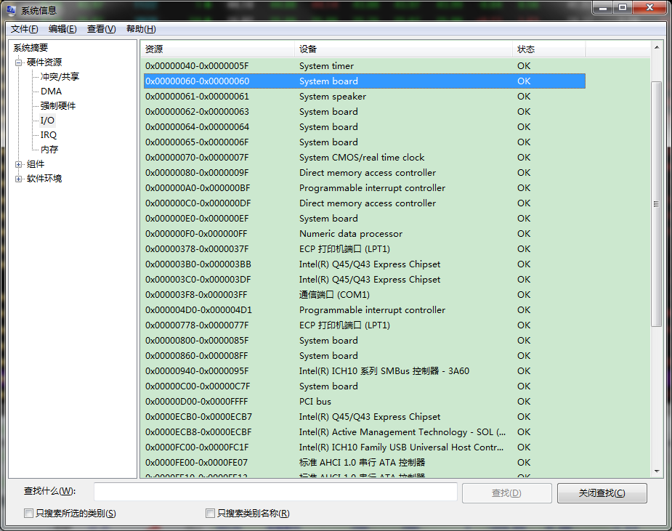

Slide 70
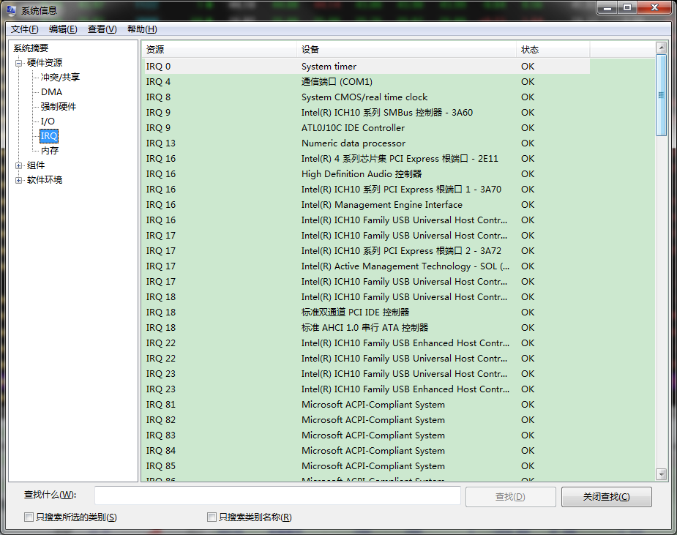

Slide 71
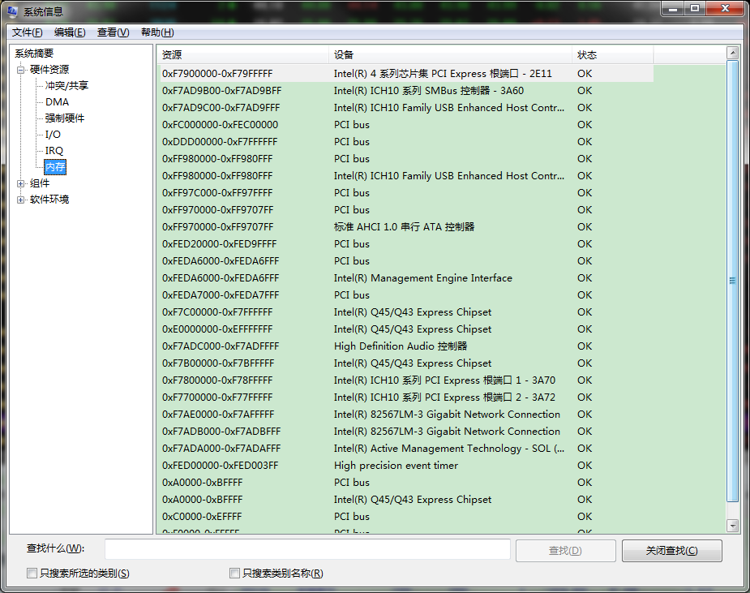

Slide 72
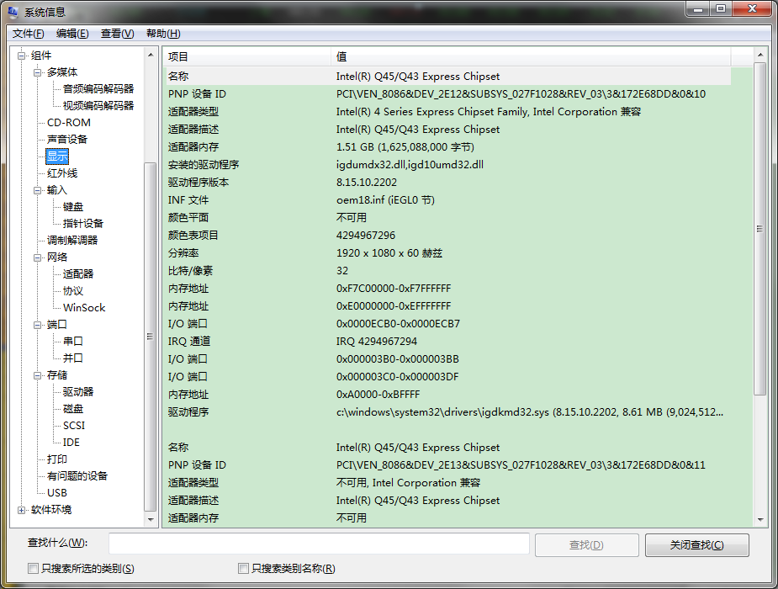

Slide 73
Communication with the Processor
I/O SYTEM DATA TRANSFER CONTROL MODE
Polling: The processor periodically checks status bit to see if it is time for the next I/O operation.
Interrupt: When an I/O device wants to notify processor that it has completed some operation or needs attentions, it causes processor to be interrupted.
DMA (direct memory access): the device controller transfer data directly to or from memory without involving processor.

Slide 74
Compare polling, interrupts, DMA
The disadvantage of polling is that it wastes a lot of processor time. When the CPU polls the I/O devices periodically， the I/O devices maybe have no request or have not get ready.
If the I/O operations is interrupt driven, the OS can work on other tasks while data is being read from or written to the device.
Because DMA doesn’t need the control of processor, it will not consume much of processor time.

Slide 75
Interrupt-Driven I/O mode
Advantage: concurrent operation
Service for interruption
Service for interruption
Running
main program
go on doing
main program
main program
CPU
t
Response
interrupt
start
I/O
Response
interrupt
return
Interrupt return
Transfer
Data
Transfer
Data
Ready
Printing
Printing
t
Printer
Idle
start
Request
interrupt
Request
interrupt
Incept Data
Incept Data

Slide 76
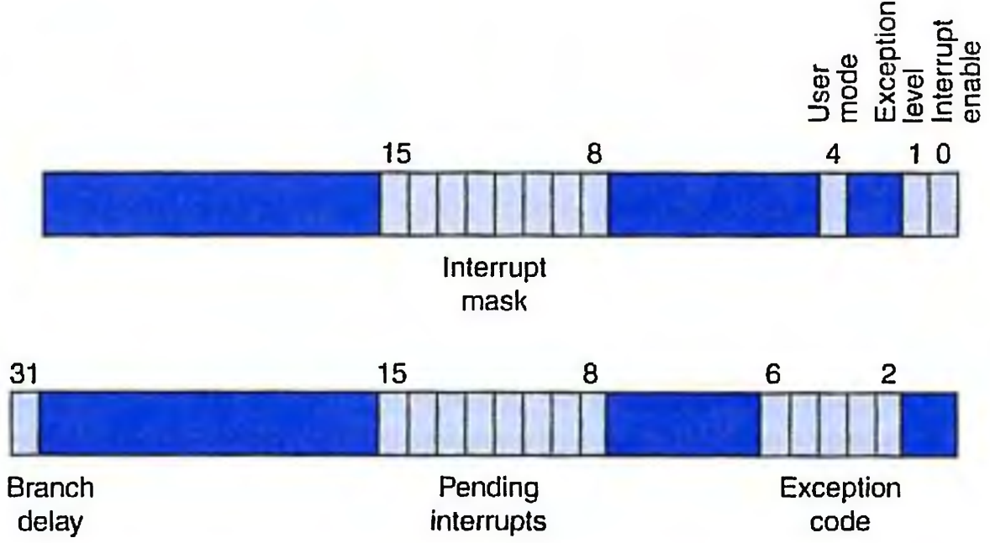
Interrupt Priority Levels
indicate the order in which the processor should process interrupts.
Status Register
Cause Register

Slide 77
Steps that must occur in handling an interrupt
1. Logically AND the pending interrupt field and the interrupt mask field to see which enabled interrupts could be the culprit. Copies are made of these two registers using the mr c0 instruction.
2. Select the higher priority of these interrupts. The software convention is that the leftmost is the highest priority.
3. Save the interrupt mask field of the Status register.
4. Change the interrupt mask field to disable all interrupts of equal or lower priority.
5. Save the processor state needed to handle the interrupt.
6. To allow higher-priority interrupts, set the interrupt enable bit of the Cause register to 1.
7. Call the appropriate interrupt routine.
8. Before restoring state, set the interrupt enable bit of the Cause register to 0. This allows you to restore the interrupt mask field.

Slide 78
Order of interruption processing
Priority of Hardware
D1, D2, D3, D4 → highest 1>2>3>4 lowest
Coming IRQ Main H1, H2, H3, H4
D3, D2
D4
D1
Time t

Slide 79
Why we need Interrupt Mask ?
Change the order of interruption processing ( handle lower level interrupt first in some extend)
To decide whether a I/O unite work on interruption way
In a multiprocessor system, distribute the I/O tasks to multiprocessor

Slide 80
Changing interrupt processing order
I/O unit | Hardware priority | interrupt mask1 D1 D2 D3 D4 | Interrupt mask2 D1 D2 D3 D4
D1 | 1 | 1 1 1 1 | 1 0 0 0
D2 | 2 | 0 1 1 1 | 1 1 0 0
D3 | 3 | 0 0 1 1 | 1 1 1 0
D4 | 4 | 0 0 0 1 | 1 1 1 1

Slide 81
Using the interrupt mask1
Coming IRQ Main H1, H2, H3, H4
D3, D2
D4
D1
Time t

Slide 82
DMA transfer mode
CPU
DMA
I/O DEVICE
memory
CPU INITIATION DMA
NO DMA I/O-CPU--M
DMA-- I/O---M I/O DIRECT ACCESS MEMORY

Slide 83
Steps of DMA transfer
The processor sets up the DMA by supplying some information, including the identity of the device, the operation, the memory address that is the source or destination of the data to be transferred, and the number of bytes to transfer.
The DMA starts the operation on the device and arbitrates for the bus. If the request requires more than one transfer on the bus, the DMA unit generates the next memory address and initiates the next transfer.
Once the DMA transfer is complete, the controller interrupts the processor, which then examines whether errors occur.

Slide 84
6.7 I/O Performance Measures: Examples for Disk and File Systems
Supercomputer I/O Benchmarks
Transaction Processing I/O Benchmarks
I/O rate: the number of disk access per second, as opposed to data rate.
File System I/O Benchmarks
MakeDir, Copy, ScanDir, ReadAll, Make

Slide 85
Performance analysis of
Synchronous vs. Asynchronous buses
Assume: The synchronous bus has a clock cycle time of 50 ns, and each
bus transmission takes 1 clock cycle .
The asynchronous bus requires 40 ns per handshake.
The data portion of both buses is 32 bits wide.
Question: Find the bandwidth for each bus when reading one word from a 200-ns memory.
synchronous bus:
the bus cycles is 50 ns. The steps and times required for the
synchronous bus are follows:
1. Send the address to memory : 50ns
2. Read the memory : 200ns
3. Send the data to the device : 50ns
Thus, the total time is 300 ns. So,
the bandwidth = 4bytes/300ns = 4MB/0.3seconds = 13.3MB/second
Answer:

Slide 86
asynchronous bus:
handshake overlap with the memory access time.
memory receives the address at the end of step 1
Memory not need to put the data on the bus until the beginning of step 5;
steps 2, 3, and 4 can
overlap with the memory
access time.
This leads to the following timing:
step1: 40ns
step2,3,4: maximum(2×40ns+40ns, 200ns)=200ns
step5,6,7: 3×40ns=120ns
Thus, the total time is 360ns, so
the maximum bandwidth = 4bytes/360ns = 4MB/0.36sec = 11.1MB/second
Accordingly, the synchronous bus is about 20% faster.

Slide 87
Increasing the Bus Bandwidth
Increasing data bus width
Use separate address and data lines
transfer multiple words
Performance Analysis of Two Synchronous Bus Schemes.
Suppose we have a system with the following characteristic:
1. A memory and bus system supporting block access of 4 to 16 32-bit words
2. A 64-bit synchronous bus clocked at 200 MHz, with each 64-bit transfer taking 1 clock cycle, and 1 clock cycle required to send an address to memory.
3. Two clock cycles needed between each bus operation.
4. A memory access time for the first four words of 200ns; each additional set of four words can be read in 20 ns. Assume that a bus transfer of the most recently read data and a read of the next four words can be overlapped.

Slide 88
Find the sustained bandwidth and the latency for a read of 256 words for transfers that use 4-word blocks and for transfers that use 16-word blocks.
Also compute effective number of bus transactions per second for each case.

Slide 89
Answer:
64-bit synchronous bus
the 4-word block transfers:
each block takes
1. 1 clock cycle to send the address to memory
2. 200ns/(5ns/cycle) = 40 clock cycles to read memory
3. 2 clock cycles to send the data from the memory
4. Two clock cycles needed between each bus operation.
This is a total of 45cycles.
There are 256/4 = 64 blocks.
So the transfer of 256 words takes
45×64=2880 clock cycles
The latency for the transfer of 256 words is:
2880 cycles× 5ns/cycle = 14,400ns.

Slide 90
so the number of bus transactions per second is:
The bus bandwidth is:
1second
(256
×
4)bytes
×
＝
71.11 MB/sec
14,
400
ns

Slide 91
the 16-word block transfers:
the first block requires
1. 1 clock cycle to send an address to memory
2. 200ns or 40 cycles to read the first four words in memory.
3. 2 cycles to transfer the data of the set, during which time the read of the next 4-word set is started.
4. It only takes 20ns or 4 cycles to read the next set. After the read is completed, the set will be transferred. Each of the three remaining sets requires repeating only the last two steps.
5. Two clock cycles needed between each bus operation.

Slide 92
Thus, the total number of cycles for each 16- word block is:
1+40+4×3+2+2=57 cycles.
There are 256/16=16 blocks.
so the transfer of 256 words takes 57×16=912 cycles.
Thus the latency is:
912cycles× 5ns/cycles = 4560ns.
Note that the bus size need to be 128 bits !
1+40+4 + 8*3 = 69 cycles
69*16 = 1104 cycles
1104 * 5ns = 5520ns
send
read
send
read
send
read
send
read
send
read
send
read
read
read
send
send
interval
interval
interval
interval
interval
interval
interval
1
40
40
4(20ns)
4(20ns)
4(next)
4(next)
4(next)
4(next)

Slide 93
The number of bus transactions per second with 16-word blocks is:
1second
(16
transactions
×
＝
2.90 M Transactions/sec
5520
ns
The bus bandwidth with 16-word blocks is:
1second
(256
×
4)bytes
×
＝
224.56 MB/sec
4560
ns
1second
(256
×
4)bytes
×
＝
185.50 MB/sec
5520
ns
Now,let’s put two bus bandwidth together:
4-word blocks: 71.11 MB/sec; 16-word blocks:224.56 MB/sec
The bandwidth for the 16-word blocks is 3.16 times higher than for the 4-word blocks.
2.6 times

Slide 94
Overhead of Polling in an I/O System
Assume: that the number of clock cycles for a polling operation is
400 and that processor executes with a 500-Mhz clock.
Determine the fraction of CPU time consumed for the mouse, floppy disk, and hard disk.
We assuming that you poll often enough so that no data is ever lost and that those devices are potentially always busy.
We assume again that:
1. The mouse must be polled 30 times per second to ensure that we do not miss any movement made by the user.
2. The floppy disk transfers data to the processor in 16-bit units and has a data rate of 50 KB/sec. No data transfer can be missed.
3. The hard disk transfers data in four-word chunks and can transfer at 4 MB/sec. Again, no transfer can be missed.

Slide 95
Answer:
the mouse:
clock cycles per second for polling :
30×400=12,000 cycles
Fraction of the processor clock cycles consumed is
the floppy disk:
the number of polling access per second:
50KB/2B = 25K
clock cycles per second for polling: 25K×400cycles
Fraction of the processor clock cycles consumed:

Slide 96
the hard disk:
The number of polling access per second : 4MB/16B = 250K
Clock cycles per second for polling = 250K×400
Fraction of the processor clock cycles consumed:
Now, let’s put three fractions together:
Mouse: 0.002%
Floppy disk: 2%
Hard disk: 20%
Clearly, polling can be used for the mouse without much performance impact on the processor, but it is unacceptable for a hard disk on this machine.

Slide 97
Suppose we have the same hard disk and processor we used in the former example, but we used interrupt-driven I/O. The overhead for each transfer, including the interrupt, is 500 clock cycles. Find the fraction of the processor consumed if the hard disk is only transferring data 5% of the time.
Answer: First, we assume the disk is transferring data 100% of the time. So, the interrupt rate is the same as the polling rate.
Cycles per second for disk is:
250K×500=125×10⁶cycles per second Fraction of the processor consumed during a transfer is:

Slide 98
Now,we assume that the disk is only transferring data 5% of the time.The fraction of the processor time consumed on average is:
25%×5%=1.25%
As we can see, no CPU time is needed when an interrupt-driven I/O device is not actually transferring. This is the major advantage of an interrupt-driven interface versus polling.

Slide 99
Overhead of I/O Using DMA
Suppose we have the same hard disk and processor we used in the former example.
Assume that the initial setup of a DMA transfer takes 1000 clock cycles for the processor, and assume the handling of the interrupt at DMA completion requires 500 clock cycles for the processor.
The hard disk has a transfer rate of 4MB/sec and uses DMA. The average transfer from disk is 8 KB. Assume the disk is actively transferring 100% of the time.
Please find what fraction of the processor time is consumed.

Slide 100
Time for each 8KB transfer is: 8KB/(4MB/second)=2×10⁻³seconds. It requires the following cycles per second:
Answer
Fraction of processor time:
Unlike either polling or interrupt-driven I/O, DMA can be used to interface a hard disk without consuming all the processor cycles for a single I/O.

Slide 101
6.8 Designing an I/O system
The general approaches to designing I/O system
Find the weakest link in the I/O system, which is the component in the I/O path that will constrain the design. Both the workload and configuration limits may dictate where the weakest link is located.
Configure this component to sustain the required bandwidth.
Determine the requirements for the rest of the system and configure them to support this bandwidth.

Slide 102
I/O System Design
Examples:
Consider the following computer system:
1. A CPU sustains 3 billion instructions per second and it takes average 100,000 instructions in the operating system per I/O operation.
2. A memory backplane bus is capable of sustaining a transfer rate of 1000 MB/sec.
3. SCSI-Ultra320 controllers with a transfer rate of 320 MB/sec and accommodating up to 7 disks.
4. Disk drives with a read/write bandwidth of 75 MB/sec and an average seek plus rotational latency of 6 ms.

Slide 103
If the workload consists of 64-KB reads (assuming the the data block is sequential on a track), and the user program need 200,000 instructions per I/O operation, please find the maximum sustainable I/O rate and the number of disks and SCSI controllers required.
Answer:
The two fixed component of the system are the memory bus and the CPU. Let’s first find the I/O rate that these two components can sustain and determine which of these is the bottleneck.

Slide 104
Instruction execution rate
Maximum I/O rate of CPU =
Instruction per I/O
3
×
10
9
I/Os
=
＝
10000
3
seconds
(200
＋
100)
×
10
Bus bandwidth
1000
×
10
6
I/Os
Maximum I/O rate of bus =
=
= 15625
Bytes per I/O
64
×
10
3
seconds
The CPU is the bottleneck, so we can now configure the rest of the system to perform at the level dictated by the bus, 10000 I/Os per second.

Slide 105
Now, let’s determine how many disks we need to be able to Accommodate 10000 I/Os per second. To find the number of disks, we first find the time per I/O operation at the disk:
Time per I/O at disk =
Seek/rotational time + Transfer time
64KB
= 6 ms
＋
= 6.9 ms
75MB/sec
This means each disk can complete 1000ms/6.9ms, or 146 I/Os per second. To saturate the bus, the system need 10000/146≈69 disks.

Slide 106
To compute the number of SCSI buses, we need to know the average transfer rate per disk, which is given by:
Transfer size
64KB
Transfer rate =
=
≈ 9.56MB/sec
Transfer time
6.9ms
Assuming the disk accesses are not clustered so that we can use all the bus bandwidth, we can place 7 disks per bus and controller. This means we will need 69/7, or 10 SCSI buses and controllers.

Slide 107
Interrupt-driven IO
Interrupts were introduced.
External device signals need to be serviced.
Processor saves state and starts service routine.
When finished, processor restores state and resumes program.

Slide 108
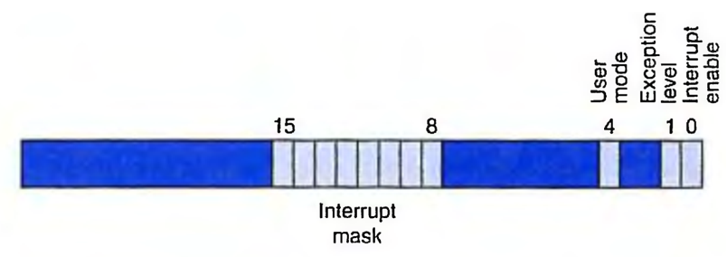
Process State
What state is needed to completely capture the state of a running process?
Processor Status Register--PSR
Program Counter
Pointer to next instruction to be executed.
Registers
All temporary state of the process that’s not stored in memory.

Slide 109
Where to Save Processor State?
Can’t use registers.
Programmer doesn’t know when interrupt might occur, so she can’t prepare by saving critical registers.
When resuming, need to restore state exactly as it was.
Memory allocated by service routine?
Must save state before invoking routine, so we wouldn’t know where.
Also, interrupts may be nested – that is, an interrupt service routine might also get interrupted!
Use a stack!
Location of stack “hard-wired”.
Push state to save, pop to restore.

Slide 110
Supervisor Stack
A special region of memory used as the stack for interrupt service routines.
Initial Supervisor Stack Pointer (SSP) stored in Saved.SSP.
Another register for storing User Stack Pointer (USP): Saved.USP.
SP(R29) as stack pointer.
So that our PUSH/POP routines still work.
When switching from User mode to Supervisor mode (as result of interrupt), save (R29) to Saved.USP.

Slide 111
Invoking the Service Routine and back
Save the PC of the instruction stage to EPC, so that can return back from exception handler.
Close interrupt to avoid any other intervention in interrupt handling. Entering kernel mode (set supervisor mode). Save the current mode EM.
Transfer to exception handler via setting PC to EHB
Protect processor state: save all GPRs to stack; Save EPC and interrupt cause register to supervisor stack.
Handling the interrupt ……
Restore processor state: restore all GPRs from stack.
Return back to the interrupt point （ERET)： open interrupt, set PC to EPC ) , back to the old mode EM.

Slide 112
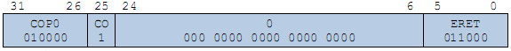
Returning from Interrupt
Special instruction – ERET – that restores state.
Pop PC from supervisor stack. (PC = EPC(CP0-R14) )
Pop PSR from supervisor stack. (PSR = State（CP0-R12 ））
If back to usemode , then R29 = Saved.USP. (If going back to user mode, need to restore User Stack Pointer.)
ERET is a privileged instruction.
Can only be executed in Supervisor Mode.
If executed in User Mode, causes an exception. (More about that later.)

Slide 113
Privileged instructions for supporting interrupt
Privileged instructions can be only used at kernel mode ( supervisor mode )
MTC0 -- Move one GPR to one of CP0 register
MFC0 –Move one of the CP0 register to one GPR.
ERET – return back to interrupt point from interrupt handler. (open interrupt, set PC to EPC )

Slide 114
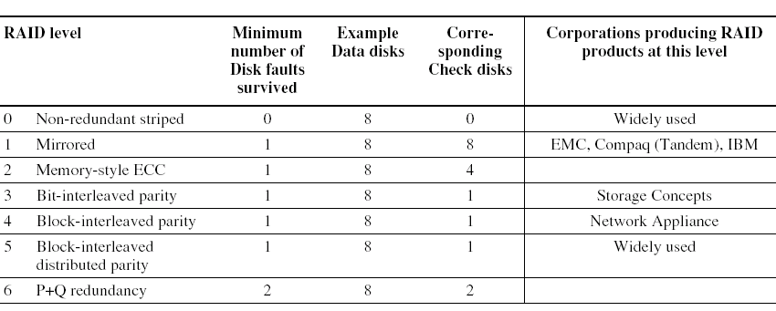
6.9 Parallelism and I/O: Redundant Arrays of Inexpensive Disks
Impact of I/O on System Performance
Elapsed time= CPU time + I/O time
RAID
redundant arrays of inexpensive disks

Slide 115
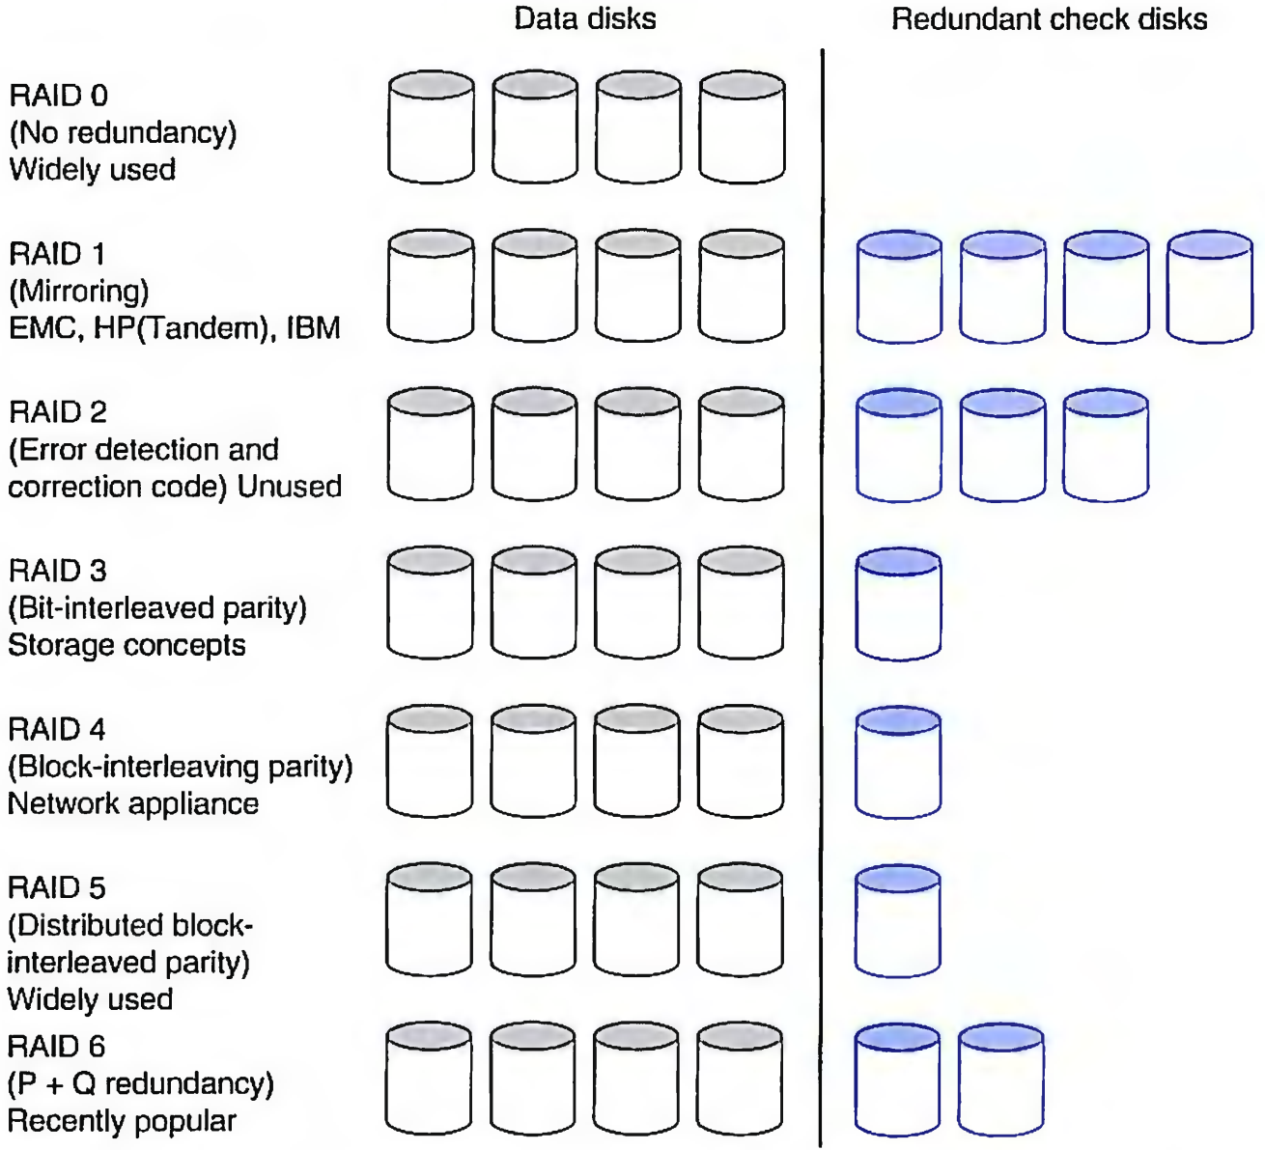
RAID: Redundant Arrays of Inexpensive Disks
A disk arrays replace larger disk

Slide 116
Use Arrays of Small Disks?
Katz and Patterson asked in 1987:
Can smaller disks be used to close gap in performance between disks and CPUs?
Conventional: 4 disk designs
3.5”
5.25”
10”
14”
Low End
High End
Disk Array: 1 disk design
3.5”

Slide 117
Array Reliability
Reliability of N disks = Reliability of 1 Disk ÷ N
50,000 Hours ÷ 70 disks = 700 hours
Disk system MTTF: Drops from 6 years to 1 month!
• Arrays (without redundancy) too unreliable to be useful!
Hot spares support reconstruction in parallel with access: very high media availability can be achieved

Slide 118
Redundant Arrays of (Inexpensive) Disks
Files are "striped" across multiple disks
Redundancy yields high data availability
Availability: service still provided to user, even if some components failed
Disks will still fail
Contents reconstructed from data redundantly stored in the array
⇒ Capacity penalty to store redundant info
⇒ Bandwidth penalty to update redundant info

Slide 119
RAID 0: No Redundancy
• Data is striped across a disk array but there is no redundancy to tolerate disk failure.
It also improves performance for large accesses,
since many disks can operate at once.
RAID 0 something of a misnomer as there is no Redundancy,

Slide 120
RAID 1: Disk Mirroring/Shadowing
recovery
group
• Each disk is fully duplicated onto its “mirror”
Very high availability can be achieved
• Bandwidth sacrifice on write:
Logical write = two physical writes
Reads may be optimized
• Most expensive solution: 100% capacity overhead
(RAID 2 not interesting, so skip)

Slide 121
RAID 3: Bit-Interleaved Parity Disk
10010011
11001101
10010011
. . .
P
logical record
1
0
1
0
0
0
1
1
1
1
0
0
1
1
0
1
1
0
1
0
0
0
1
1
1
1
0
0
1
1
0
1
Striped physical
records
P contains sum of
other disks per stripe mod 2 (“parity”)
If disk fails, subtract
P from sum of other disks to find missing information

Slide 122
Inspiration for RAID 4
RAID 3 relies on parity disk to discover errors on Read
But every sector has an error detection field
Rely on error detection field to catch errors on read, not on the parity disk
Allows independent reads to different disks simultaneously

Slide 123
RAID 4: High I/O Rate Parity
Increasing
Logical
Disk
Address
D0
D1
D2
D3
P
Insides of 5 disks
D4
D5
D6
D7
P
D8
D9
D10
D11
P
Example:
small read D0 & D5, large write D12-D15
D12
D13
D14
D15
P
Stripe
D16
D17
D18
D19
P
D20
D21
D22
D23
P
.
.
.
.
.
.
.
.
.
.
.
.
.
.
.
Disk Columns

Slide 124
Problems of Disk Arrays: Small Writes
RAID-5: Small Write Algorithm
1 Logical Write = 2 Physical Reads + 2 Physical Writes
D0'
D0
D1
D2
D3
P
new
data
old
data
(1. Read)
old
parity
(2. Read)
+
XOR
+
XOR
(3. Write)
(4. Write)
D0'
D1
D2
D3
P'

Slide 125
Inspiration for RAID 5
RAID 4 works well for small reads
Small writes (write to one disk):
Option 1: read other data disks, create new sum and write to Parity Disk
Option 2: since P has old sum, compare old data to new data, add the difference to P
Small writes are limited by Parity Disk: Write to D0, D5 both also write to P disk
D0
D1
D2
D3
P
D4
D5
D6
D7
P

Slide 126
RAID 5: High I/O Rate Interleaved Parity
D0
D1
D2
D3
P
Increasing
Logical
Disk
Addresses
Independent writes
possible because of
interleaved parity
D4
D5
D6
P
D7
D8
D9
P
D10
D11
D12
P
D13
D14
D15
Example: write to D0, D5 uses disks 0, 1, 3, 4
P
D16
D17
D18
D19
D20
D21
D22
D23
P
.
.
.
.
.
.
.
.
.
.
.
.
.
.
.
Disk Columns

Slide 127
RAID 6: P+Q Redundancy
When a single failure correction is not sufficient, Parity can be generalized to have a second calculation over data and another check disk of information.

Slide 128
Summary: RAID Techniques: Goal was performance, popularity due to reliability of storage
1
0
0
1
0
0
1
1
1
0
0
1
0
0
1
1
• Disk Mirroring, Shadowing (RAID 1)
Each disk is fully duplicated onto its "shadow"
Logical write = two physical writes
100% capacity overhead
• Parity Data Bandwidth Array (RAID 3)
1
0
0
1
0
0
1
1
1
1
0
0
1
1
0
1
1
0
0
1
0
0
1
1
0
0
1
1
0
0
1
0
Parity computed horizontally
Logically a single high data bw disk
• High I/O Rate Parity Array (RAID 5)
Interleaved parity blocks
Independent reads and writes
Logical write = 2 reads + 2 writes

Slide 129
RAID alternatives
RAID7：优化的高速数据传送磁盘结构
RAID10/01：高可靠性与高效磁盘结构
RAID 10是先镜射再分区数据，将所有硬盘分为两组，视为是RAID 0的最低组合，然后将这两组各自视为RAID 1运作。
RAID 01则是跟RAID 10的程序相反，是先分区再将数据镜射到两组硬盘
RAID 50：分布奇偶位阵列条带
具有RAID 5和RAID 0的共同特性
由两组RAID 5磁盘组成（每组最少3个），每一组都使用了分布式奇偶位，而两组硬盘再组建成RAID 0
RAID 53：称为高效数据传送磁盘结构
结构的实施同Level 0数据条阵列，其中，每一段都是一个RAID 3阵列
RAID 1.5：具有RAID 0+1的特性，只需要2个硬盘
RAID 1E：RAID 1的增强版本
RAID 5E：在 RAID 5级别基础上的改进
RAID 5EE：提供了一个完善的替代"RAID5+HotSpare"盘的解决办法
RAID ADG：类似于RAID 6，ADG技术是基于RAID5之上的，采用了冗余的校验盘
RAID 3DP：NEC公司的NEC Storage D存储系列产品使用的一种私有RAID级别，它由6或10个磁盘驱动所构成。

Slide 130
END

